Slide 1
ECEG-5193: Algorithm Analysis and Design
Analysis of Sorting and Searching algorithms
Trees

Slide 2
What is a Tree?
A tree is a collection of nodes with the following properties:
The collection can be empty.
Otherwise, a tree consists of a distinguished node r, called root, and zero or more nonempty sub-trees T₁, T₂, … , T_{k}, each of whose roots are connected by a directed edge from r.
The root of each sub-tree is said to be child of r, and r is the parent of each sub-tree root.
If a tree is a collection of N nodes, then it has N-1 edges.
root
T₁
T₂
...
T_{k}

Slide 3
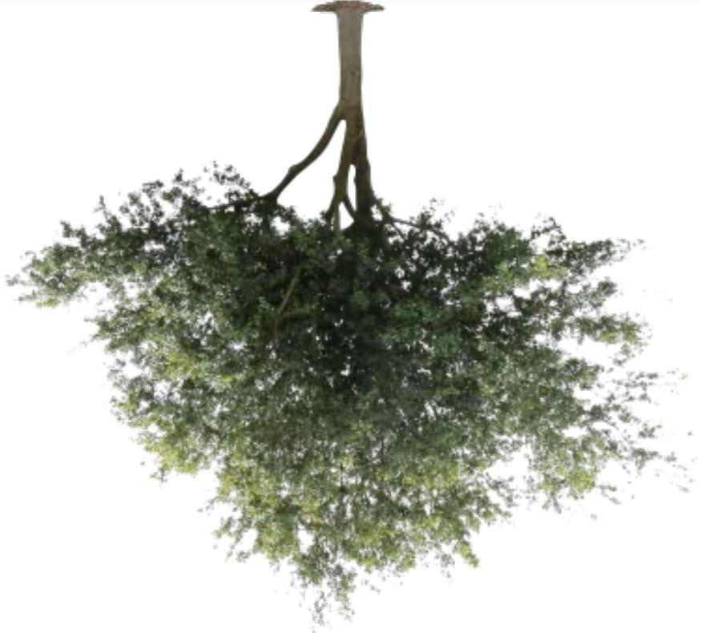
Natural Tree
Computer Tree

Slide 4
Preliminaries
A
B
C
D
E
F
G
H
I
J
K
L
M
N
P
Q
Node A has 6 children: B, C, D, E, F, G.
B, C, H, I, P, Q, K, L, M, N are leaves in the tree above.
K, L, M are siblings since F is parent of all of them.

Slide 5
Preliminaries (continued)
A path from node n₁ to n_{k} is defined as a sequence of nodes n₁, n₂, …, n_{k} such that n_{i} is parent of n_{i+1} (1 ≤i < k)
The length of a path is the number of edges on that path.
There is a path of length zero from every node to itself.
There is exactly one path from the root to each node.
The depth of node n_{i} is the length of the path from root to node n_{i}
The height of node n_{i} is the length of longest path from node n_{i} to a leaf.
If there is a path from n₁ to n₂, then n₁ is ancestor of n₂, and n₂ is descendent of n₁.
If n₁ ≠ n₂ then n₁ is proper ancestor of n₂, and n₂ is proper descendent of n₁.

Slide 6
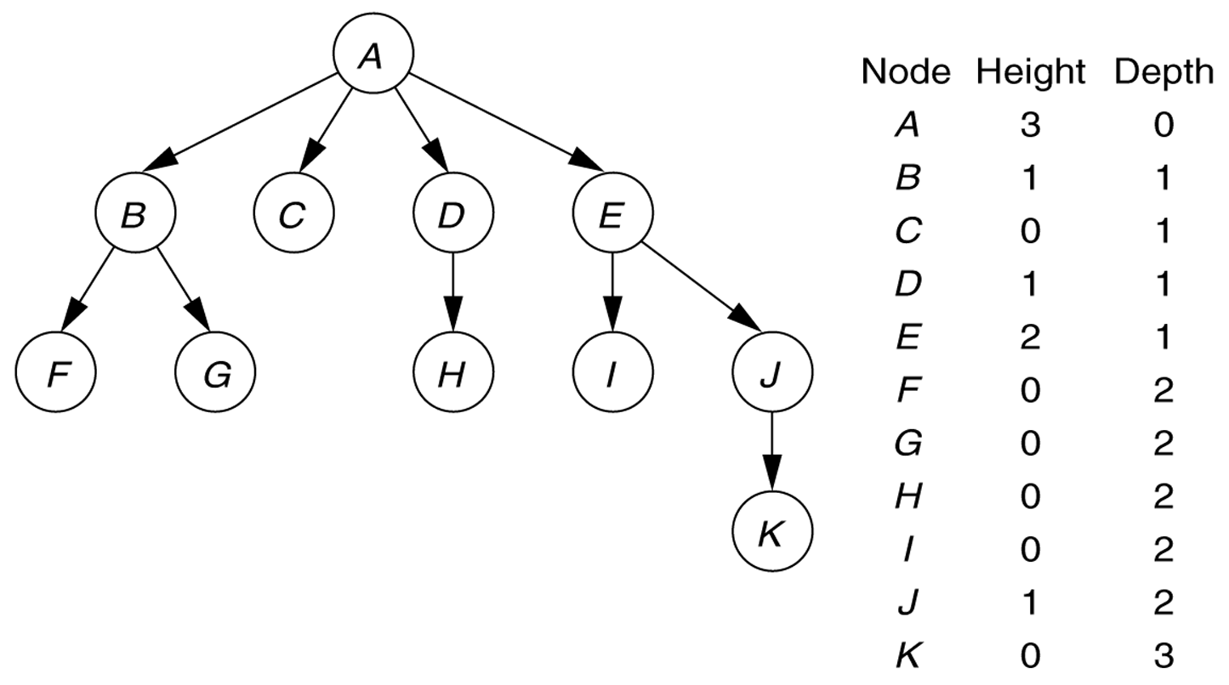
Height and Depth

Slide 7
Types of Trees

Slide 8
Binary Trees
A binary tree is a tree in which no node can have more than two children
The depth can be as large as N-1 in the worst case.
root
A binary tree consisting of a root and two subtrees T_{L} and T_{R}, both of which could possibly be empty.
T_{L}
T_{R}

Slide 9
Binary Tree Terminology
Left Child – The left child of node n is a node directly below and to the left of node n in a binary tree.
Right Child – The right child of node n is a node directly below and to the right of node n in a binary tree.
Left Subtree – In a binary tree, the left subtree of node n is the left child (if any) of node n plus its descendants.
Right Subtree – In a binary tree, the right subtree of node n is the right child (if any) of node n plus its descendants.

Slide 10
Binary Tree -- Example
A is the root.
B is the left child of A, and
C is the right child of A.
D doesn’t have a right child.
H doesn’t have a left child.
B, F, G and I are leaves.
• A
• B
• C
• D
• E
• F
• G
• H
• I

Slide 11
Height of Binary Tree
The height of a binary tree T can be defined recursively as:
If T is empty, its height is -1.
If T is non-empty tree, then since T is of the form
r
T_{L} T_{R}
the height of T is 1 greater than the height of its root’s taller subtree; i.e.
height(T) = 1 + max{height(T_{L}), height(T_{R})}

Slide 12
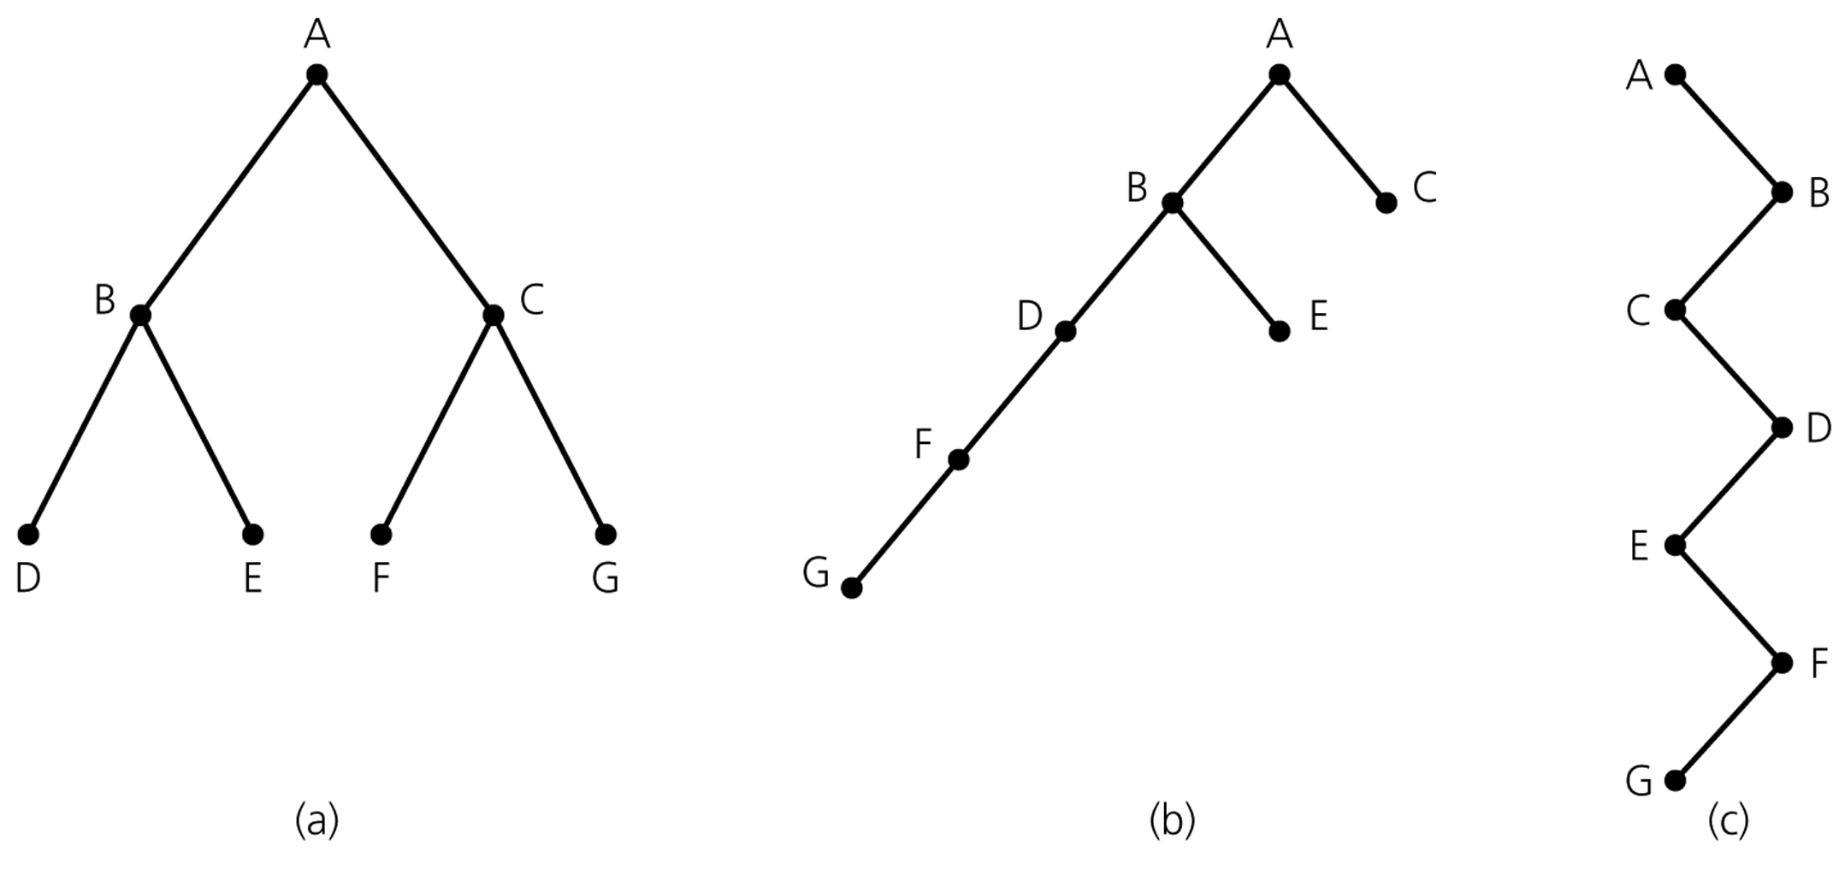
Height of Binary Tree (cont.)
Binary trees with the same nodes but different heights

Slide 13
Some Height Theorems
Theorem 1: The maximum number of nodes that a binary tree of height h can have is 2^{h+1}-1.
Theorem 2: The minimum height of a binary tree with N nodes is ⎡log₂(N+1)-1⎤ .
Let’s prove these two theorems.

Slide 14
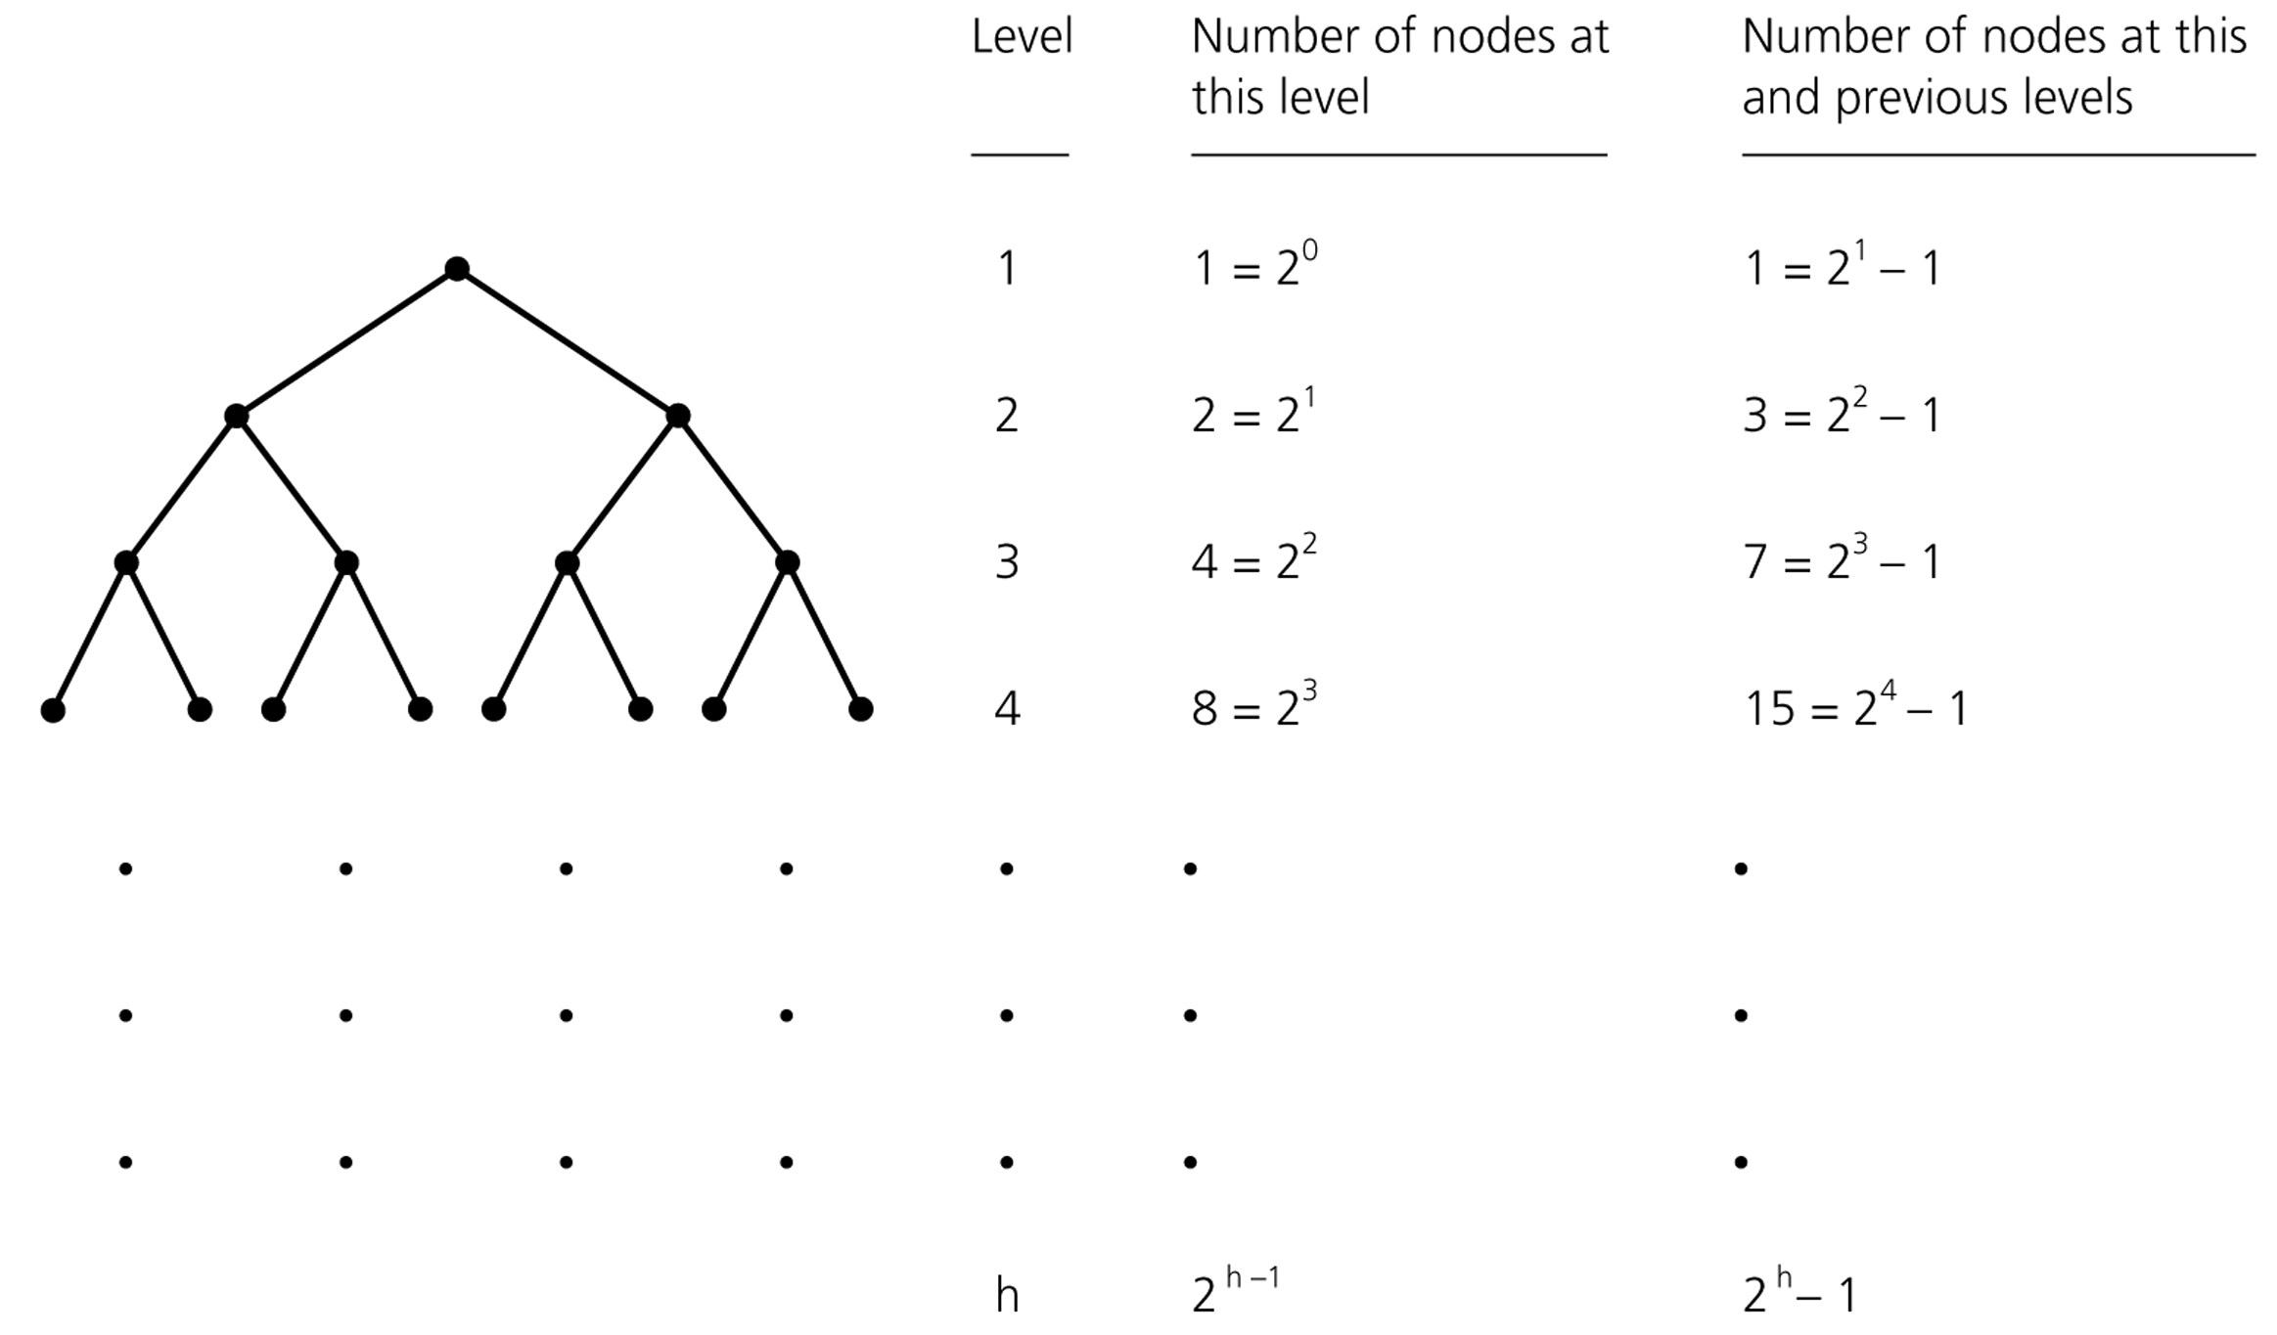
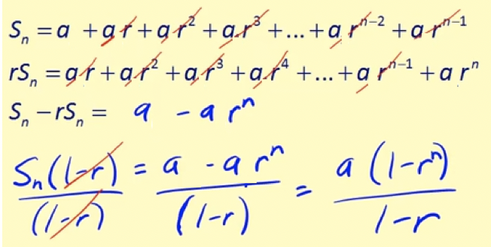
Counting the nodes in a binary tree
Height
--------
0
1
2
3
h-1
h
Theorem 1:
N = 2⁰ + 2¹ + 2² + .. + 2^{h-1}+ 2^{h}
= 1*(1-2^{h+1}) / (1-2) = 2^{h+1}-1
Use telescopic series to prove it.

Slide 15
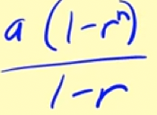
Counting the nodes in a binary tree
Theorem 1:
N = 2⁰ + 2¹ + ... + 2^{h-1}+ 2^{h}
= 1*(1 - 2^{h+1}) / (1 - 2) = 2^{h+1} - 1
This is the max # of nodes for height h, as we cannot insert one node without increasing the height. N <= 2^{h+1} - 1

Slide 16
Counting the nodes in a binary tree
Theorem 2:
N = 2^{h+1} - 1
N+1 =2^{h+1}
//take logs of sides
log(N+1) = log(2^{h+1}) = h+1
h = log(N+1)-1
h = ⎡log₂(N + 1) - 1⎤

Slide 17
Number of Binary trees with Same # of Nodes
n = 0 ➔
empty tree
n = 1 ➔
•
(1 tree)
•
•
n = 2 ➔
(2 trees)
•
•
n = 3 ➔
(? trees)

Slide 18
Number of Binary trees with Same # of Nodes
n = 0 ➔
empty tree
n = 1 ➔
•
(1 tree)
•
•
n = 2 ➔
(2 trees)
•
•
•
•
•
•
•
n = 3 ➔
•
•
(5 trees)
•
•
•
•
•
•
•
•

Slide 19
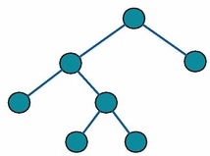
Full Binary Tree
In a full binary tree a tree in which every node in the tree has either 0 or 2 children

Slide 20
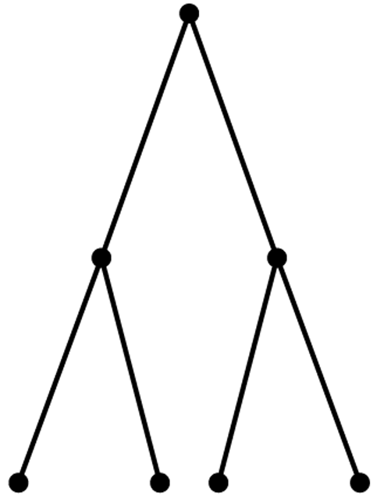
Full Binary Tree – Example
A full binary tree of height 2

Slide 21
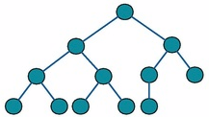
Complete Binary Tree
In a complete binary tree every level, except possibly the last, is completely filled, and all nodes in the last level are as far left as possible

Slide 22
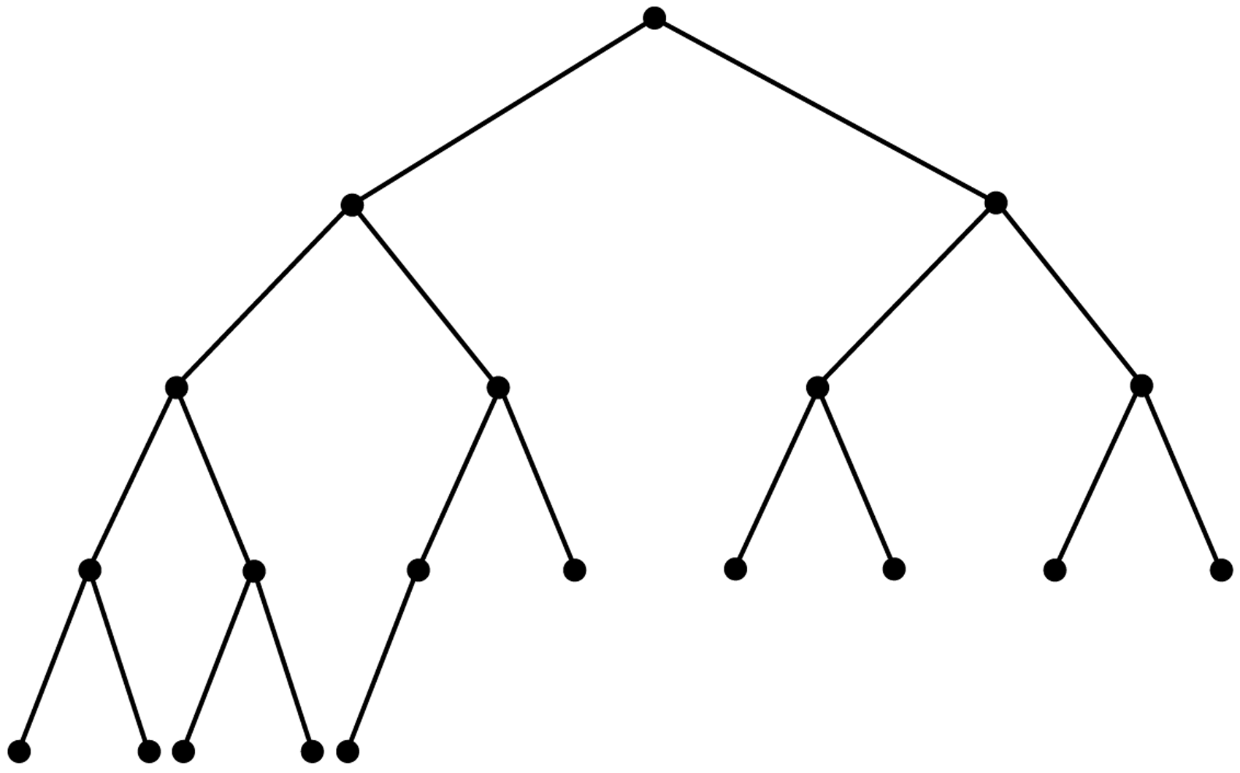
Complete Binary Tree – Example

Slide 23
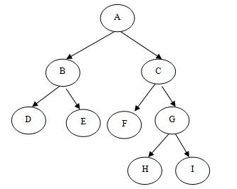
Full but Not Complete Binary Tree – Example

Slide 24

Neither Full Nor Complete Binary Tree – Example

Slide 25
Full and Complete Binary Tree – Example

Slide 26
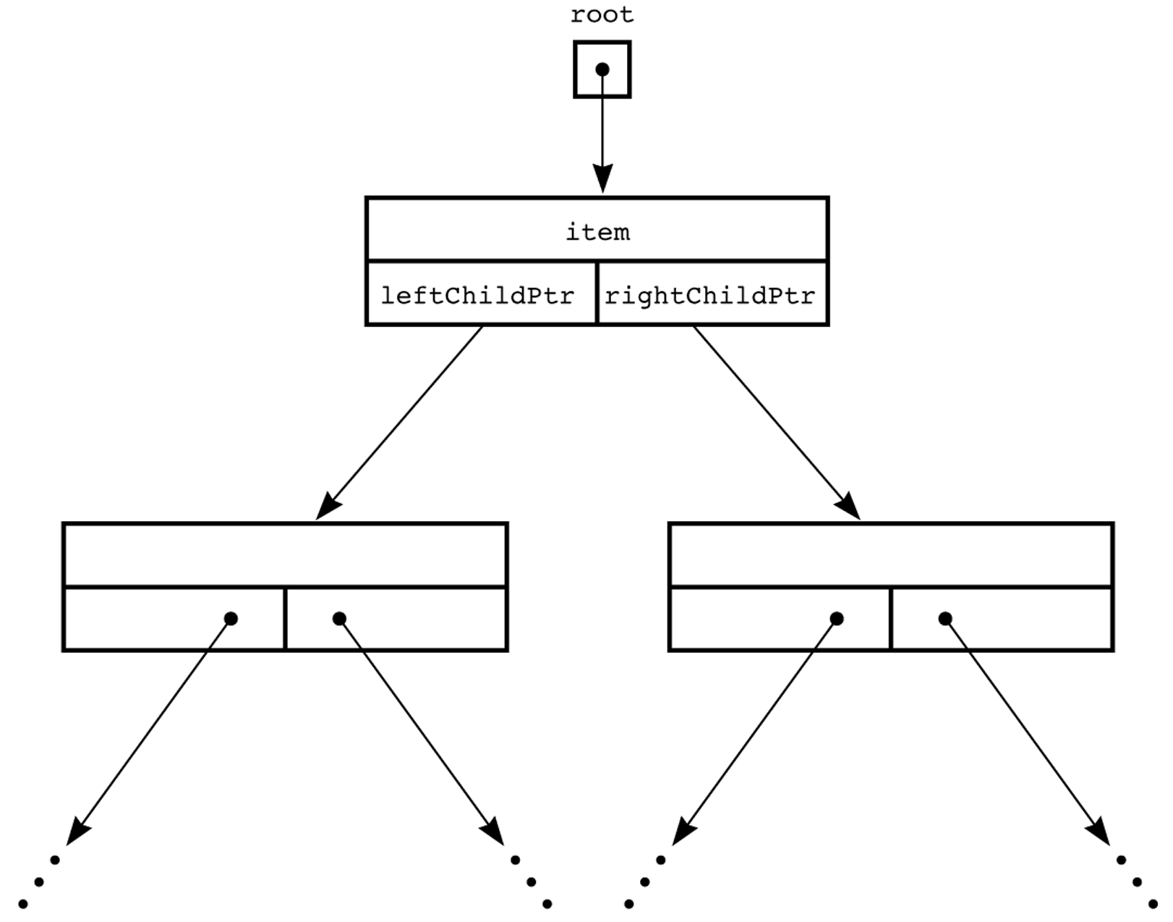
A Pointer-Based Implementation of Binary Trees
struct BinaryNode {
Object element;
struct BinaryNode *left;
struct BinaryNode *right;
};

Slide 27
‘A’
‘L’
‘G’
root_ptr
‘O’
‘R’
‘T’
data ‘A’
left
right
data ‘L’
data ‘G’
left
right
left
right
data ‘O’
data ‘R’
data ‘T’
left
right
left
right
left
right

Slide 28
Binary Search Trees
An important application of binary trees is their use in searching.
Binary search tree is a binary tree in which every node X contains a data value that satisfies the following:
all data values in its left subtree are smaller than the data value in X
the data value in X is smaller than all the values in its right subtree.
the left and right subtrees are also binary search tees.

Slide 29
Example
6
6
2
8
2
8
1
4
1
4
3
3
7
A binary search tree
Not a binary search tree, but a binary tree

Slide 30
B-Trees
B-tree is a special kind of tree, similar to a binary search tree where each node holds entries of some type.
But a B-tree is not a binary tree:
nodes can have more than two children
Nodes can contain more than just a single entry
Rules of B-tree make it easy to search for an item.
Also ensures that the leaves do not become too deep.

Slide 31
B-tree: Example
93 and 107
subtree
number 0
subtree
number 1
subtree
number 2
Each entry in subtree 0 is less than 93
Each entry in subtree 2 is greater than 107
Each entry in subtree 1 is between 93 and 107
Every node has at least MINIMUM number of entries. MINIMUM can be as small as 1, or as big as 100’s or 1000’s.

Slide 32
B-tree
Every leaf in a B-tree has the same depth.
6
2 and 4
9
1
3
5
7 and 8
10

Slide 33
Operations on B-trees
Searching for an item
Inserting item
Removing item
6
2 and 4
9
1
3
5
7 and 8
10

Slide 34
Binary Space Partitioning Tree
2D Example:
We are given a set of N points in the plane.
Each point has an associated (x,y) position.

Slide 35
Binary Space Partitioning Tree
Problem:
How to efficiently determine if a query point (x,y)
is contained in the set of points?
??

Slide 36
Possible Solutions
Go through N points comparing to see if their (x,y) value matches query point (x,y). Drawback: O(N) complexity.
Use some sort of tree structure to organize the points, and formulate query in terms of searching tree. Assuming uniform distribution of points, O(logN) complexity.
How to structure tree??? Partition space using Binary Space Partitioning (BSP).

Slide 37
Building BSP Tree
Approach:
Recursively split space in half, in such a way that
number of points in each half is roughly equal.

Slide 38
Building BSP Tree
Approach:
Recursively split space in half, in such a way that
number of points in each half is roughly equal.

Slide 39
Building BSP Tree
Approach:
Recursively split space in half, in such a way that
number of points in each half is roughly equal.

Slide 40
Building BSP Tree
Approach:
Recursively split space in half, in such a way that
number of points in each half is roughly equal.

Slide 41
Building BSP Tree
Recursively divide set of points using planes positioned that split the point set roughly in half.
Stop recursively dividing when set is empty, or set is smaller than threshold M, or maximum tree depth is reached.

Slide 42
BSP Tree
Result:

Slide 43
BSP Tree Search
Is there a point in set that matches query point (x,y)?

Slide 44
BSP Tree Search
Is there a point in set that matches query point (x,y)?

Slide 45
BSP Tree Search
Is there a point in set that matches query point (x,y)?

Slide 46
BSP Tree Search
Is there a point in set that matches query point (x,y)?

Slide 47
BSP Tree Search
Compare query point only
with those points in this leaf node.

Slide 48
BSP Tree Search: Complexity
Assume that points are randomly, uniformly distributed in space (within some range).
We recursively split point set in half at each internal node.
For analysis, assume that we allow trees of unlimited depth, and that each leaf can contain only one point.
Average case complexity, given N points?

Slide 49
Game Trees
Consider writing a computer program that plays Tic-Tac-Toe against a human...
human makes first move...
where should the computer move???
There are 8 possible choices.
X

Slide 50
Game Trees
The computer can make 8 possible moves
X
Each possible choice represents one
node at that level in the game tree.
Which one should be chosen??

Slide 51
Game Tree: Look Ahead
For each possible move, see what possible moves are for opponent.
For instance:
X
O
Each node represents a possible move
that the opponent could take.

Slide 52
Game Tree: Look Ahead
Proceed recursively, testing all possible moves until opponent or computer wins.
X
O
X
Choose a move that leads to the most
possible winning moves!!

Slide 53
Game Trees
For each turn in the game, build game tree that tests possible move scenarios.
Choose move that maximizes number of possible wins.
Parts of the tree are reusable (depending on the opponents choice of next move).
Problem: tree is quite large. Assume we have N=9 possible positions, what is the potential size O(f(N)) number of nodes?

